Slide 1
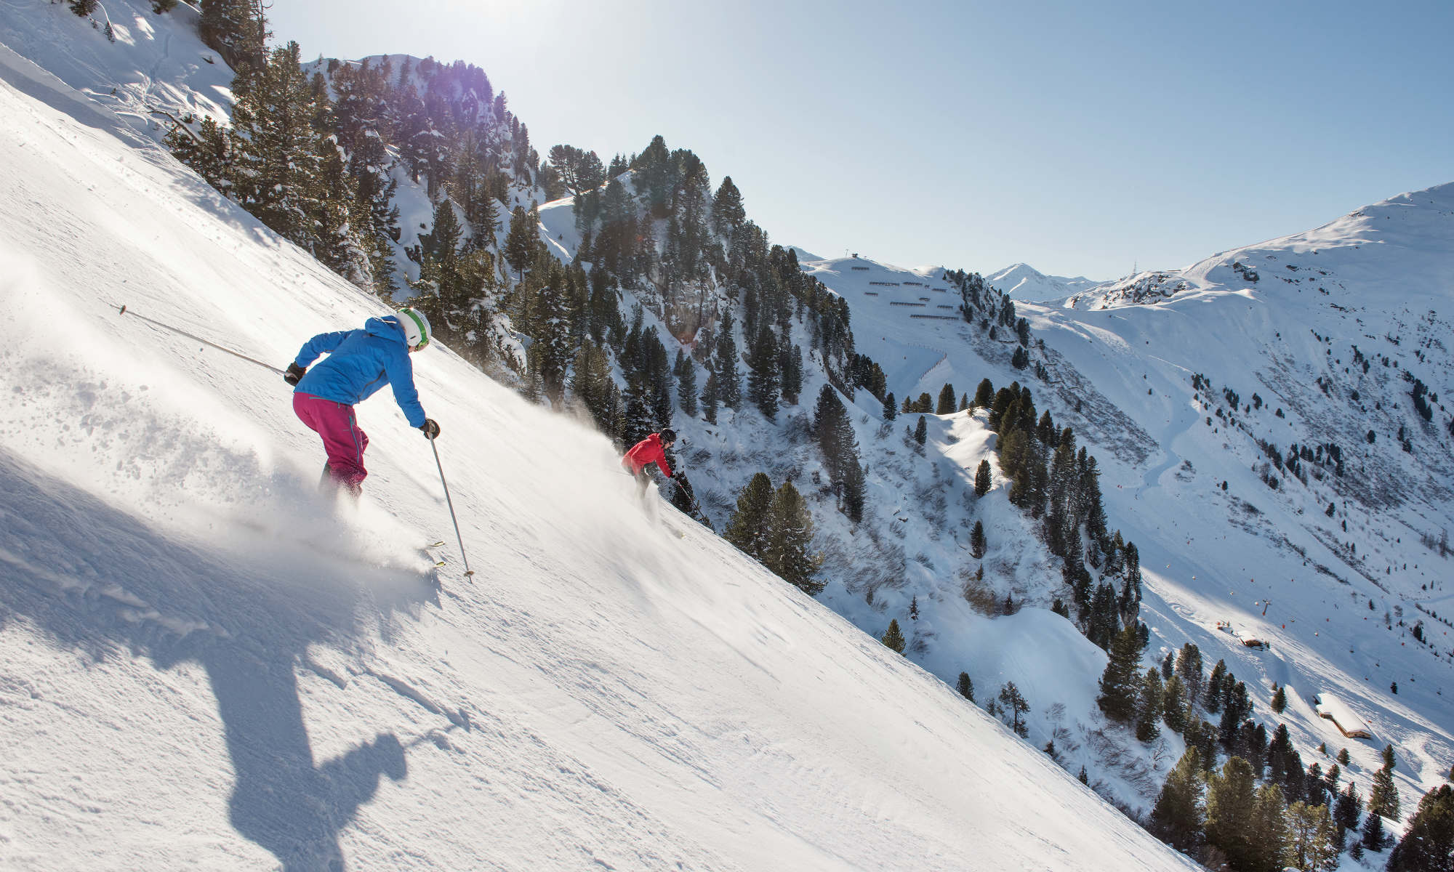

Big Mountain Ski Resort
Springboard DSC
Denzel S. Williams
September 2020 Cohort
Notes:
Think of a color exercise:
No context: Red vs. Blue
Paint Store: Teenage boy, painting room, on a budget, two paints, which is he going to choose?

Slide 2
What Features are Valuable to the Ski Experience?
Ensuring that the money spent was well deserved.

Slide 3



Key Finds & Recommendations
Selling Itself Short
The facilities that BMR offers are worth more than the customers are currently paying.
Vertical Extension
Extend the vertical drop metric of the resort by 150ft by adding a new run and a corresponding chair lift to bring riders back up.
Closing Runs
A single run could be closed, beyond that revenue begins to decline starting at $700K and reaching $2M.
Chair Lift
The operating costs of installing a chair lift in isolation is worth less than its operating cost.

Slide 4
Principal Component Analysis
To Split or Not to Split?
No Definitive Way to Split The Market. All States are Treated Equally.

Slide 5
The Same Top Features Appeared in both the Exploratory Phase and the Machine Learning Phase
The Vertical Drop
# of Fast Quads
Amount of Runs
Total Chair Lifts
Area Covered via Snow Maker
Longest Run
The Features that Matter

Slide 6
Dummy Regressor as Baseline
Linear Regression
Hyperparameter Search
Cross Validation
Random Forest
Hyperparameter Search
Cross Validation
Performance Metrics
5-Fold Cross Validation
Mean Absolute Error
Test Prediction
The Machine Learning Process
Linear Regression
Mean | Standard Deviation | Test Prediction
$10.50 | $1.62 | $11.80
Random Forest
Mean | Standard Deviation | Test Prediction
$9.64 | $1.35 | $9.53
Table Description: The summary statistics for the 5 different mean absolute error results of the 5-fold cross validation on the training data set. As well as the mean absolute error of the prediction of ticket price on the test set

Slide 7
Conclusion
By adding in a new run that extends the vertical drop metric by 150ft. and the appropriate chair lift the resort can raise the ticket price by $1.99 generated $3.4M in revenue.
The model predicted that Big Mountain Resort should have a ticket price of $95 compared to the current price of $81

Slide 8
Notes:
Think of a color exercise:
No context: Red vs. Blue
Paint Store: Teenage boy, painting room, on a budget, two paints, which is he going to choose?

